Slide 1
CSC 131 Project
Sam Lee’s Team

Slide 2
Github Link
https://github.com/DuTogira/master/tree/master/DUT-ogira's%20Project

Slide 3
First Sprint
UML Diagrams
User Stories
Tasks
Backlog
Burndown Chart

Slide 4
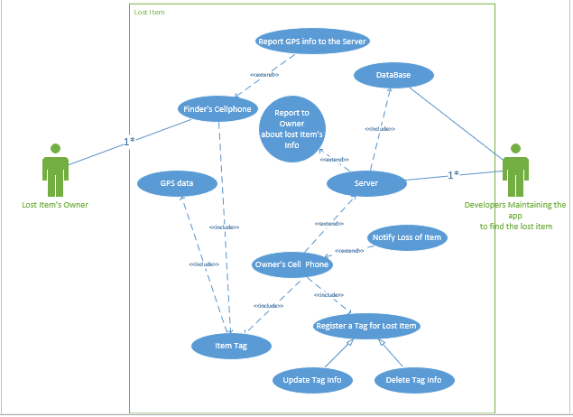
UML Use Case

Slide 5
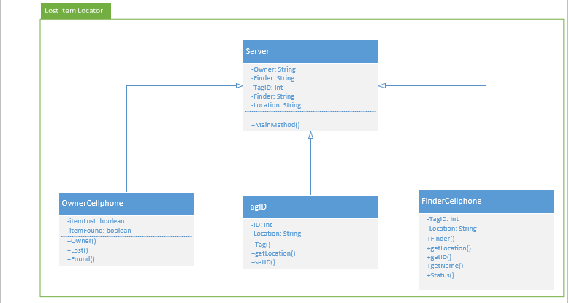
Class Diagram

Slide 6
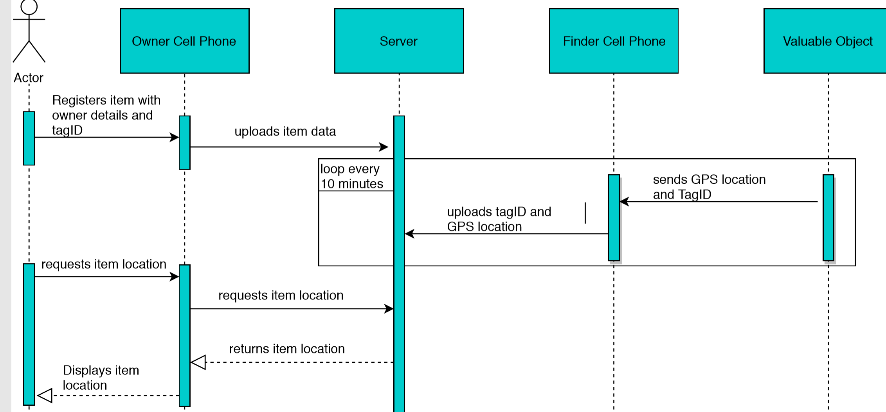
Sequence Diagram

Slide 7
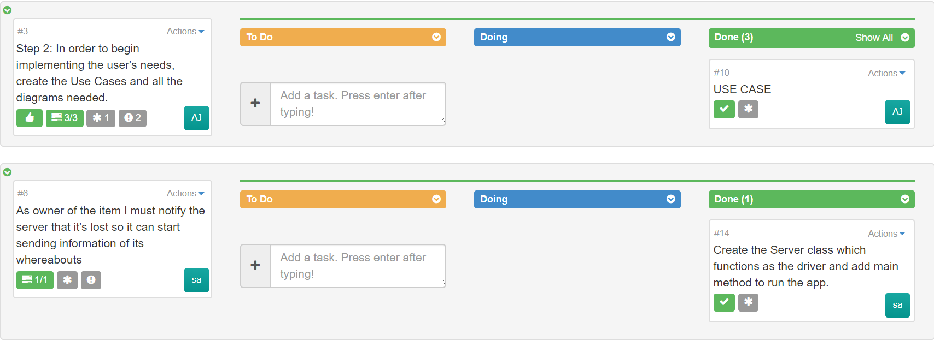
User Stories

Slide 8
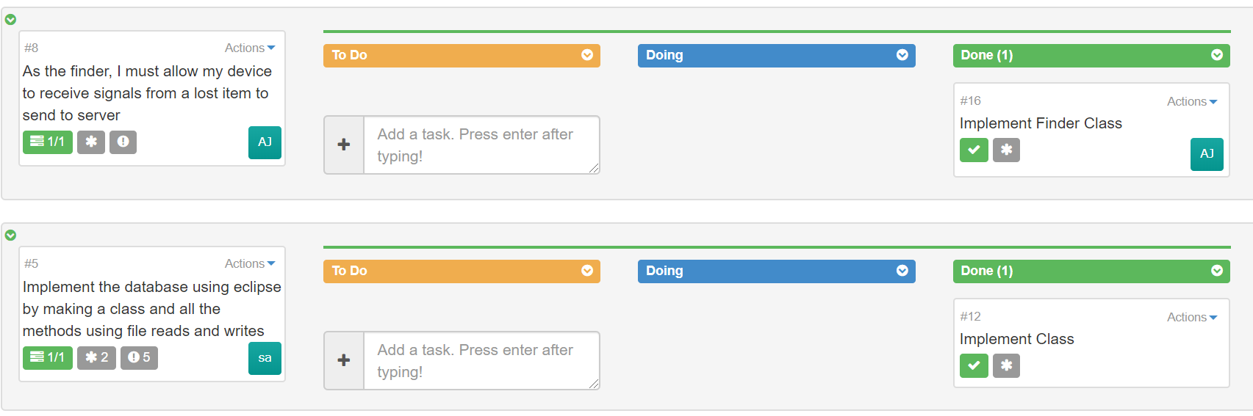
User Stories Cont.

Slide 9
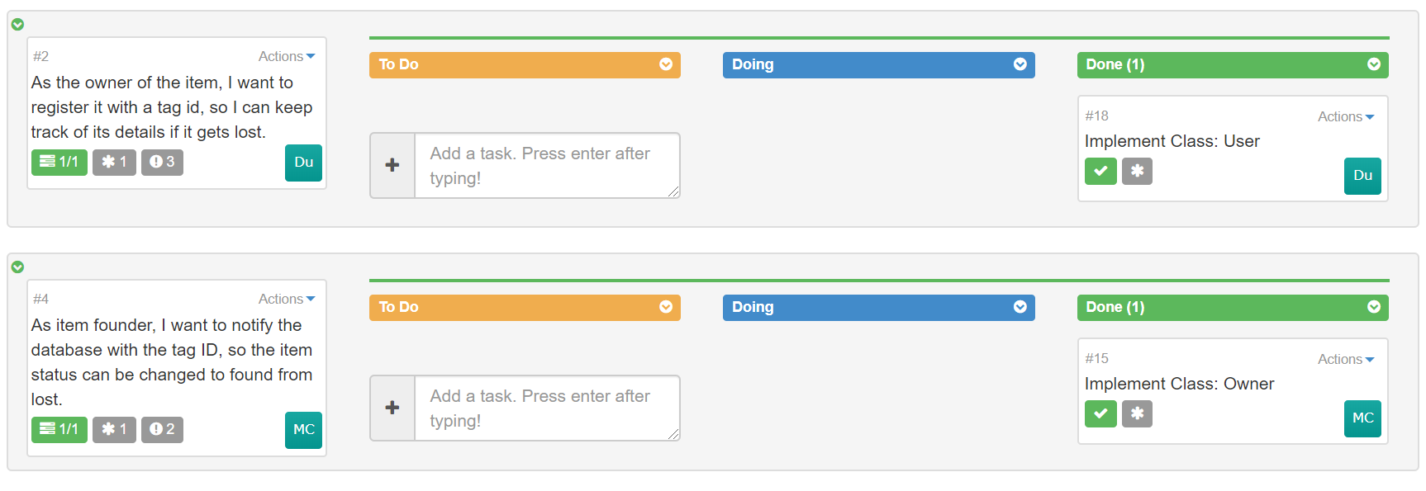
User Stories Cont.

Slide 10
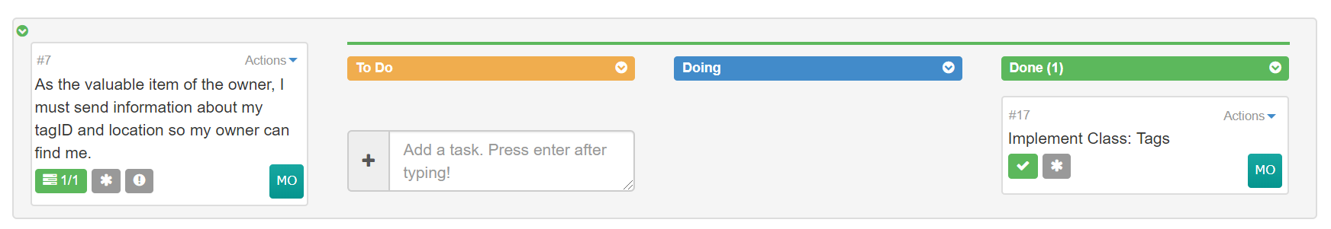
User Stories Cont.

Slide 11
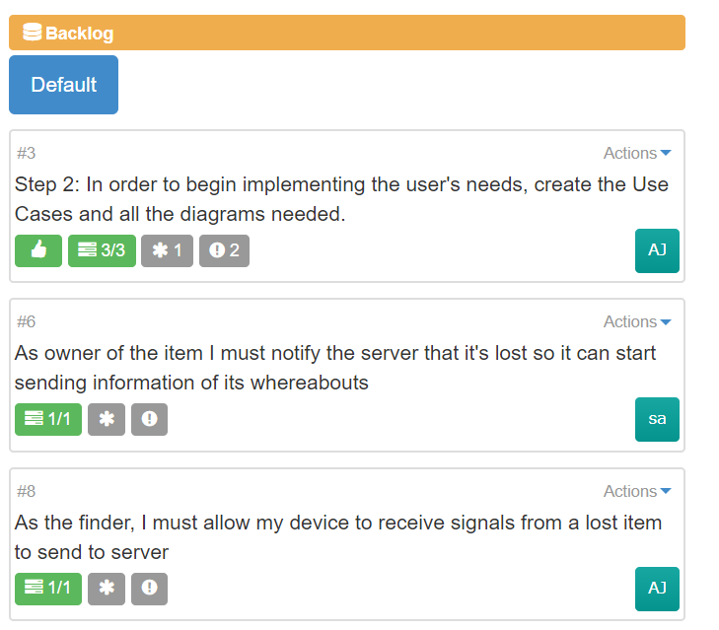
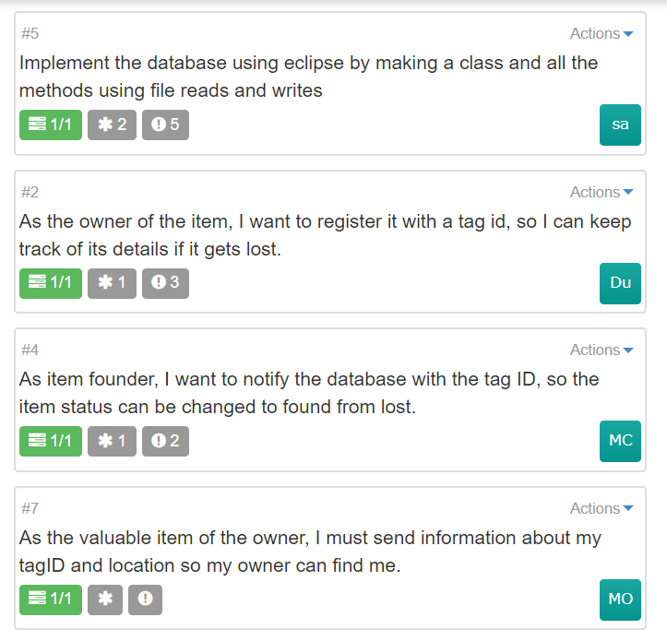
Backlog

Slide 12
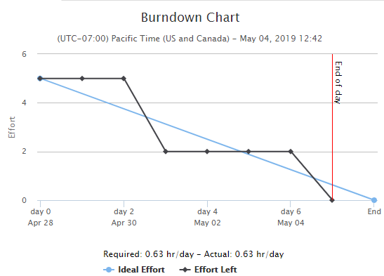
Burndown Chart

Slide 13
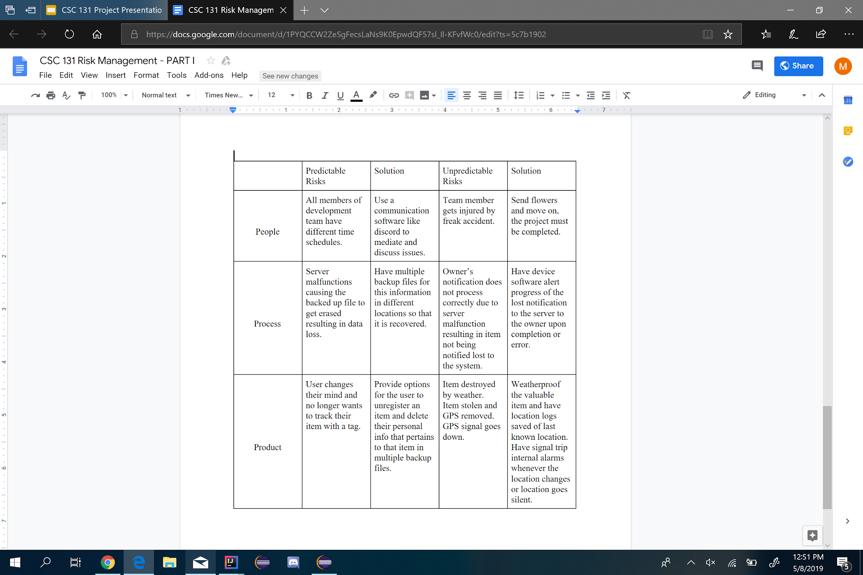
Risk Management

Slide 14
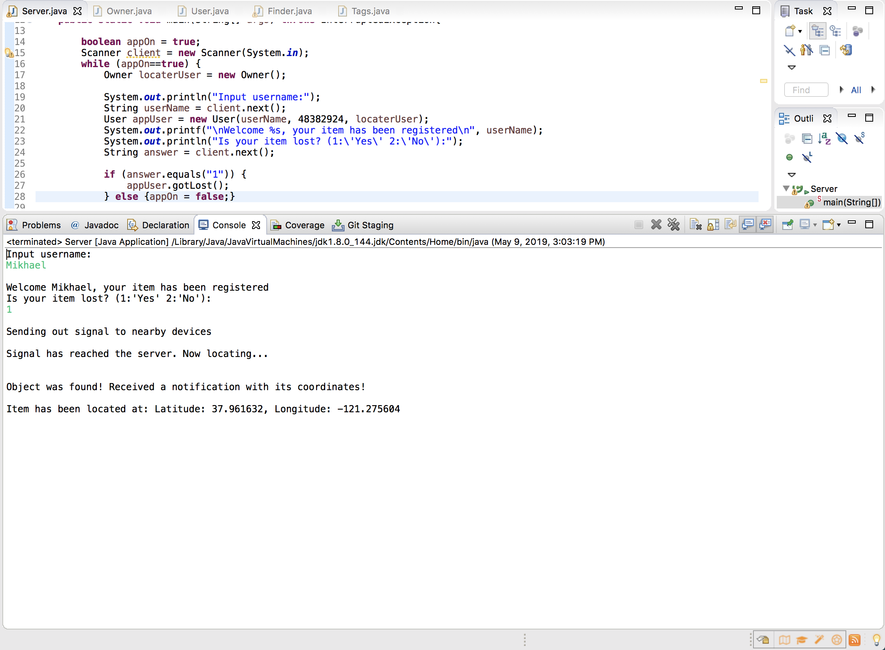
Demo Output

